Slide 1
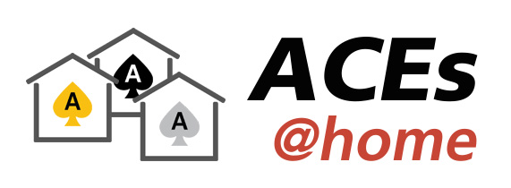
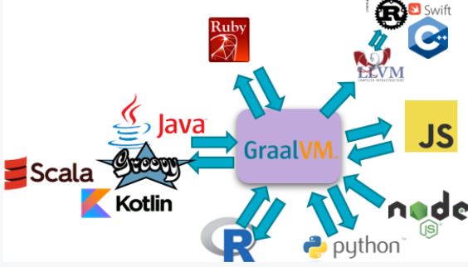





How and why GraalVM is quickly becoming relevant for you
ACEs@home – 17th June 2020
Lucas Jellema, CTO & Architect AMIS, Oracle ACE Director & Groundbreaker Ambassador

Slide 2
Demo
Notes:
Run PrimeNumbers – what happens?
JRE startup
Interpreted mode
After some time: JIT compilation of Java byte code to machine code;
After more time: runtime optimization; runs on GraalVM
What is size of runtime environment: Class file + JRE; memory footprint: 10 – 150 MB
Run native primes – what happens: instant start/execution of already natively compiled machined code
Runtime: just the executable (size 10MB)
Performance and [low] Resource Usage of Ahead of Time Compiled Java application

Slide 3
Demo
bit.ly/graalvm-handson
Notes:
Run HelloWorld – what happens?
JRE startup
JIT compilation of Java byte code to machine code; runtime optimization; runs on GraalVM
What is size of runtime environment: Class file + JRE; memory footprint: 10 – 150 MB
Run native helloworld – what happens: instant start/execution of already natively compiled machined code
Runtime: just the executable (size 10MB)
Performance and [low] Resource Usage of Ahead of Time Compiled Java application

Slide 4
GraalVM
Lean Run Time
Native Binary
Executables
Custom DSL
Polyglot
Serverless Java
JavaScript, Python, Ruby, R, C/C++
Next Gen JIT Compiler
Notes:
Overview of main themes and topics
(instead of boring list of all topics in the agenda)
We can make this slide build – to indicate the order of the topics
High-performance modern Java
Low-footprint, fast-startup Java
Combine JavaScript, Java, Ruby, and R

Slide 5

Oh boy, we will be in so much trouble…
Notes:
Spaghetti…
Hotspot C2 compiler for runtime optimizations had gotten very complicated and very hard to maintain. It does not support optimization for modern code patterns. The C++ code had gotten out of hand

Slide 6
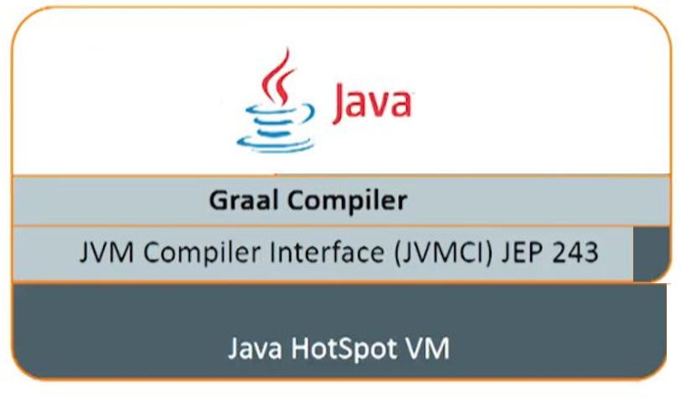
What is GraalVM?

Slide 7
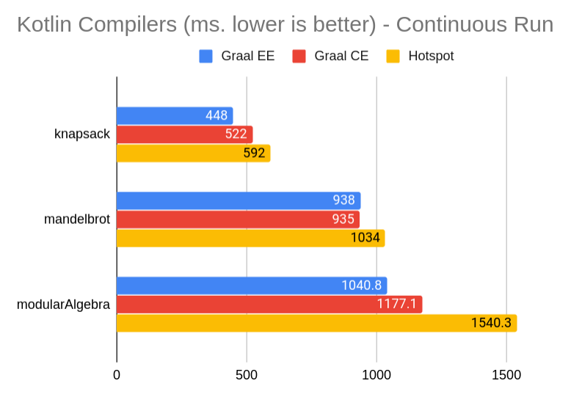
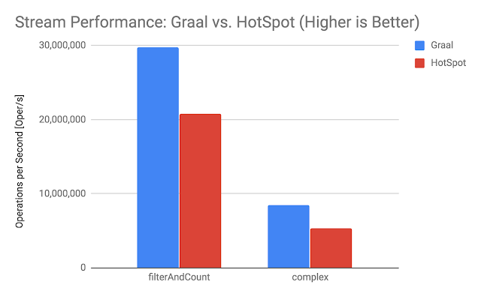
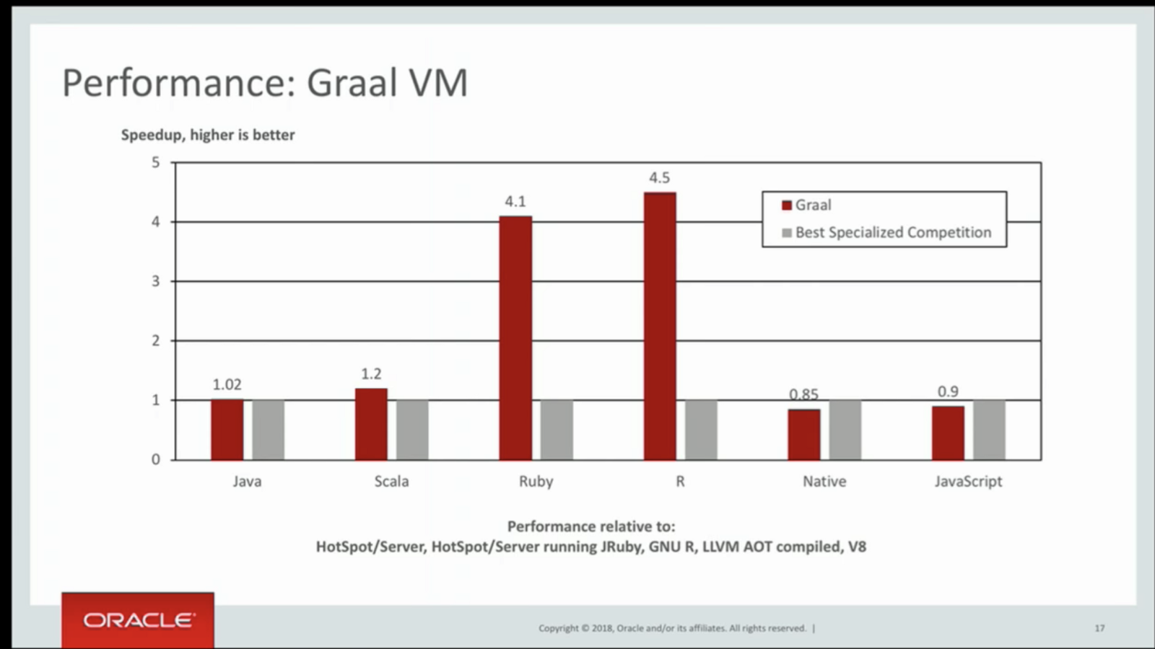
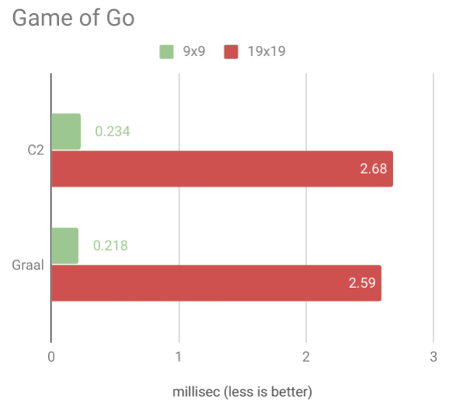
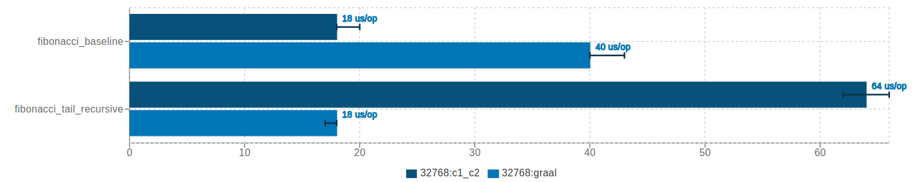
Performance and Resource Consumption of GraalVM vs C2

Slide 8
What is GraalVM - beyond a better JIT compiler?

Slide 9
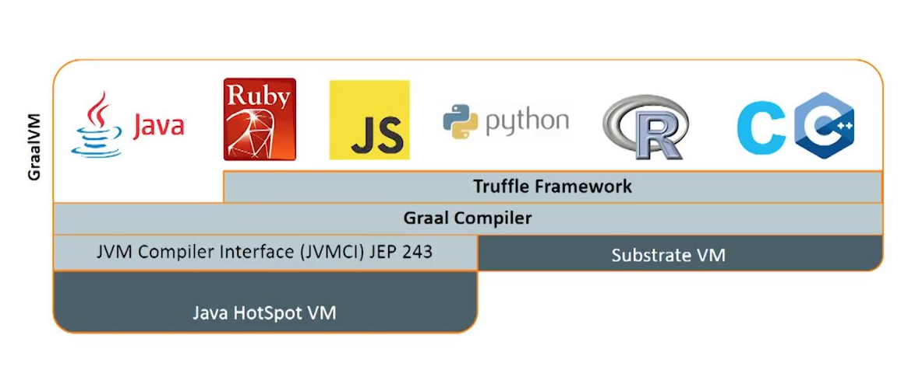
What is GraalVM - beyond a better JIT compiler?
Custom DSL
Native Image
Polyglot Tools

Slide 10
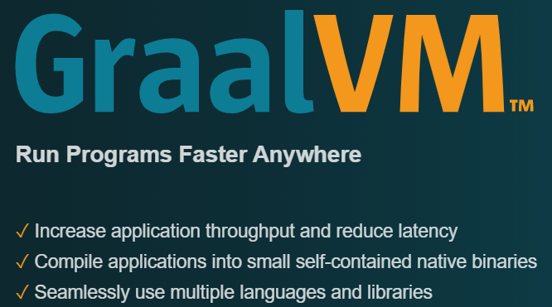
Introducing
JIT Compiler for running Java applications faster (matching native languages for speed)
Embeddable on Hotspot VM or other JVMs
Polyglot VM – for running applications in any language
JavaScript, Ruby, R, Python, C/C++
Ahead-of-Time compiler for creating native binaries
Simple, lean runtime with fast startup and minimal memory and process footprint
Interoperability platform that allows applications in one technology to interact with with modules in other technologies (“Nashorn on super steroids”)
Framework for compiling, running, interoperating and natively compiling applications written in your own DSL
Set of cross-language programming tools
Notes:
https://en.wikipedia.org/wiki/GraalVM

Slide 11


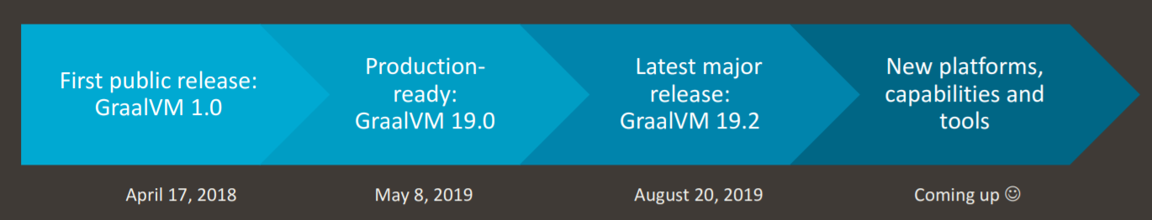

Some history on GraalVM
(limited) Spring Boot support for GraalVM native images
GraalVM support in Helidon, Micronaut & Quarkus
Project Fn GraalVM enabled
GraalVM “productized” at Oracle
Proof of Concept: a compiler written in Java (with all its software engineering advantages) could generate highly optimized code without compromising on compile times
Oracle Database MLE
Coherence support for GraalVM
WebLogic Certified on GraalVM
Spring Framework 5.3 with GraalVM AOT support
Project spun off from Maxine VM
20.1.0
2012
May, 2020
ES2020 support
Twitter started to run its many Scala applications on the GraalVM JIT Compiler to save money and CPU cycles
Java 11 support
GraalVM Advisory Board
WebAssembly support
2017
2019
Notes:
https://openjdk.java.net/projects/graal/

Slide 12
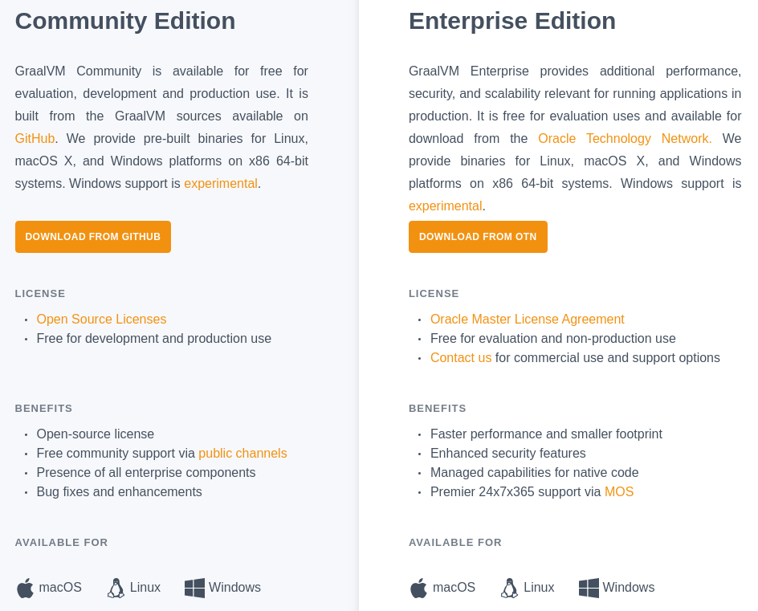
GraalVM: Two Editions
Notes:
Spaghetti…
Hotspot C2 compiler for runtime optimizations had gotten very complicated and very hard to maintain. It does not support optimization for modern code patterns. The C++ code had gotten out of hand

Slide 13

GraalVM EE included in all OCI subscriptions
GraalVM Enterprise is included in all Oracle Cloud Infrastructure (OCI) subscriptions so you can use it for no additional charge (Compute, OKE, Functions)
Notes:
https://blogs.oracle.com/graalvm/accelerating-oci-applications-with-graalvm-enterprise
For OCI user workloads, GraalVM Enterprise can be used in the following deployment scenarios:
Bare Metal and Virtual Machines (OCI Compute)
Containers (Oracle Container Engine for Kubernetes)
Functions (Oracle Functions)

Slide 14
Today, we will focus on
JIT Compiler for running Java applications faster (matching native languages)
on Hotspot VM or other traditional VMs
Polyglot VM – for running applications in any language
JavaScript, Ruby, R, Python, C/C++
Ahead-of-Time compiler for creating native binaries
Simple, lean runtime with fast startup and minimal memory and process footprint
Interoperability platform that allows applications in one technology to interact with with modules in other technologies (“Nashorn on super steroids”)
Framework for compiling, running, interoperating and natively compiling applications written in your own DSL
Set of cross-language programming tools

Slide 15

GraalVM: Polyglot Runtime

Slide 16
Polyglot Run Time

Slide 17

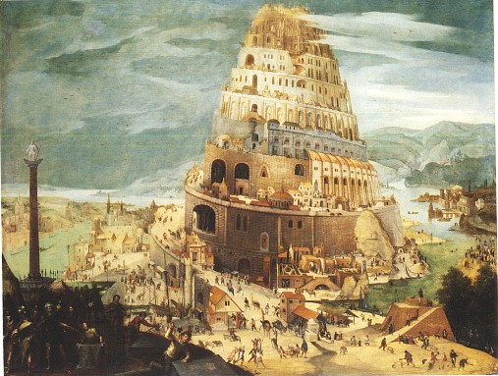






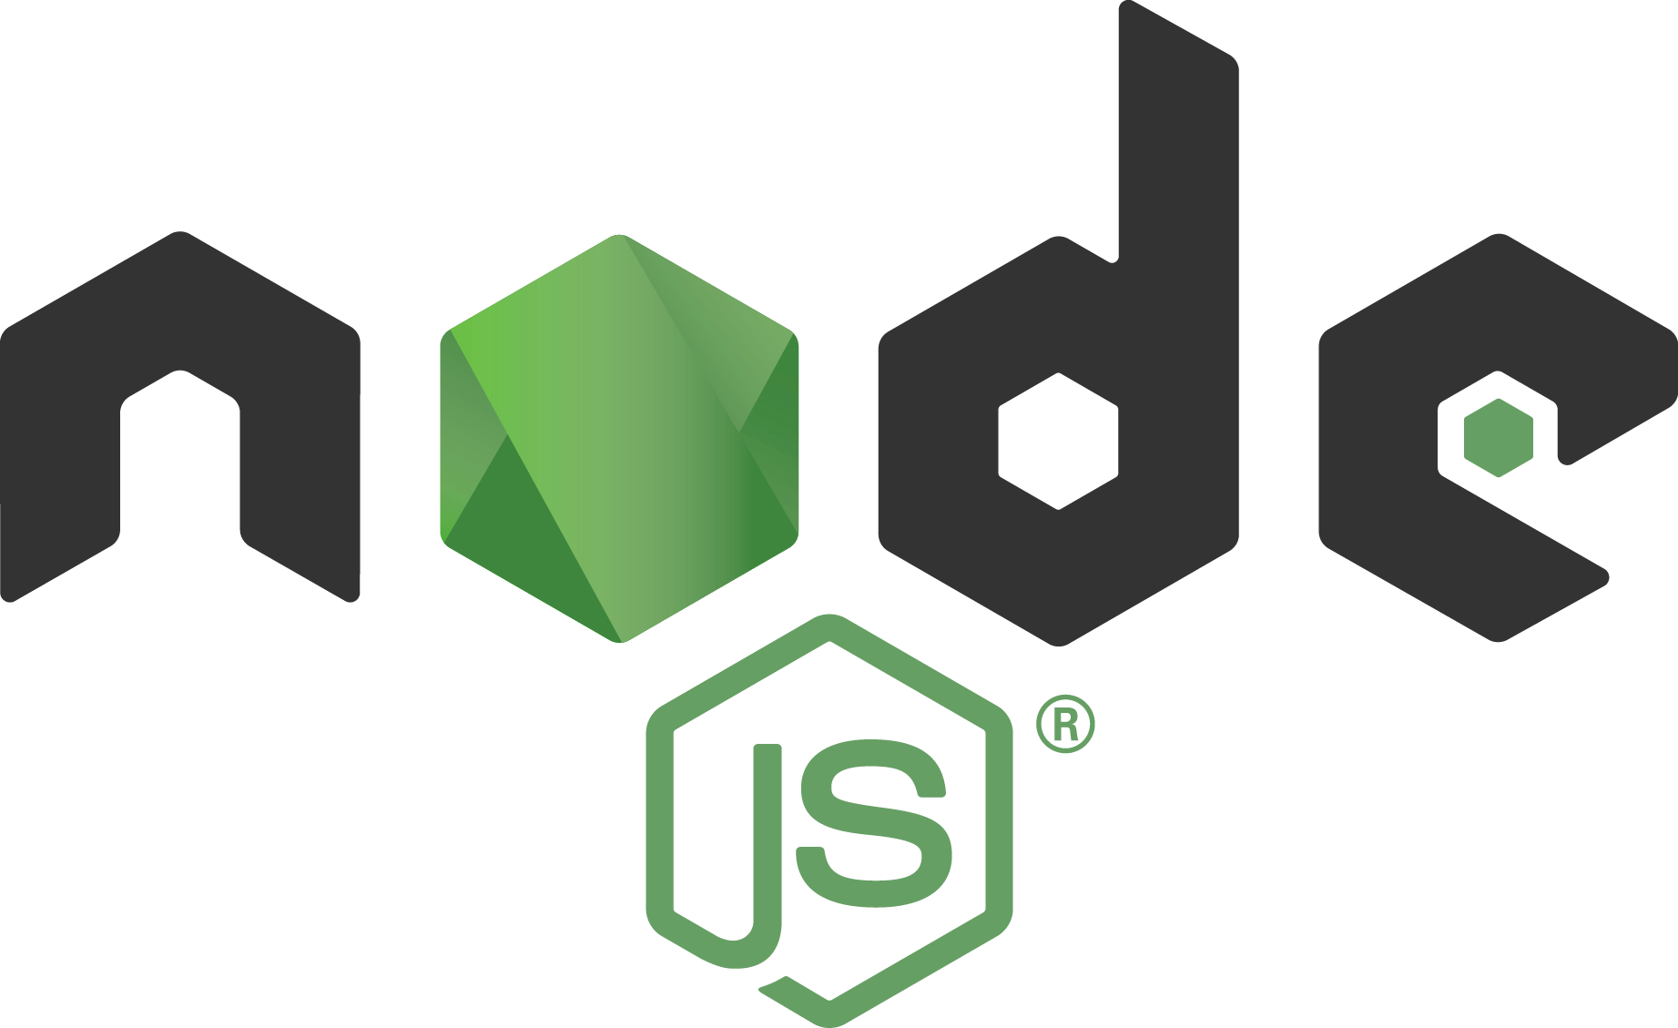









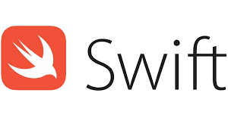
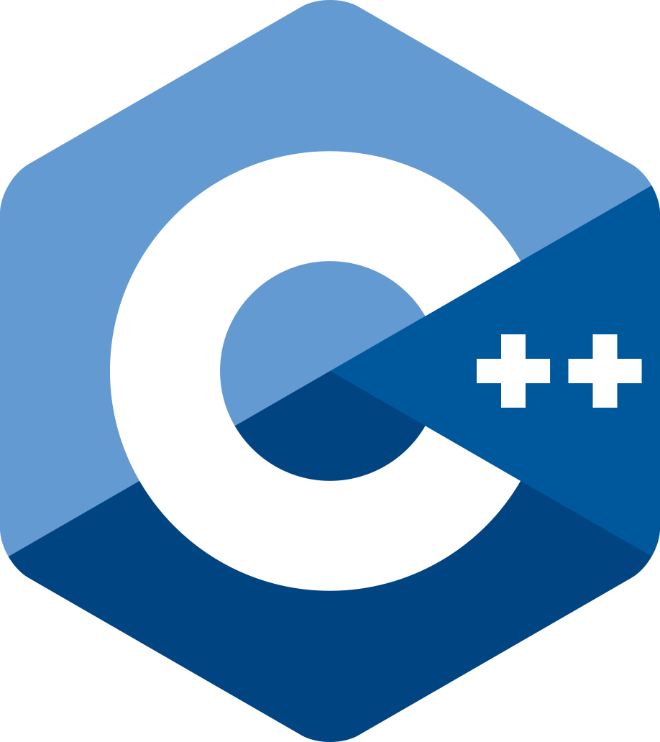



Why do we have so many languages?
Notes:
Human Languages
Computer Programming Languages
(personal taste, libraries, suitability for certain tasks, legacy)
Office politics, commercial

Slide 18



Polyglots – speak and understand many languages
Notes:
Human Languages
Computer Programming Languages
(personal taste, libraries, suitability for certain tasks, legacy)
Office politics, commercial

Slide 19


GraalVM Polyglot Runtime
GraalVM can run (on the mature, manageable, observable and run time optimized JVM)
Java
JVM Languages
Many other languages
Through Truffle produced intermediate code
Including Static Languages through Sulong- an LLVM IR interpreter
Your own Custom DSL
Truffle
Fortran
Haskell

Slide 20
GraalVM: Ahead-of-Time compiler

Slide 21
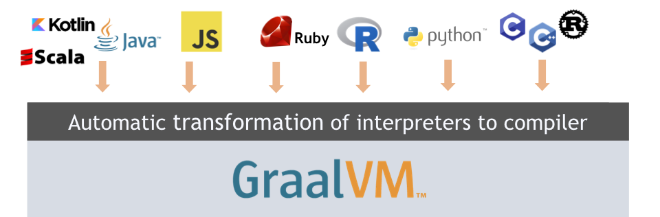
GraalVM compile modes
Notes:
At this part of our presentation, we will focus on JVM-based languages and try to explain the difference between 2 compilation modes provided by GraalVM.

Slide 22

GraalVM compile modes
JIT
java PrimeNumbers
Notes:
Let's start with (JIT) Just in Time compiler. This is the default way of compiling JVM based applications. JVM is a run-time environment that interprets Java application into Java bytecode and then uses something called a (JIT) just-in-time compiler which compiles the Java bytecode into native machine code while you are running your application. This means that a Java application gets more optimized and faster while running and this is also the reason why Java gets as fast as it is and how it can run some code faster than C++
Java HotSpot VM has two JIT compilers. C1 also called the client compiler. C1 create your first machine code. You do that because there's such a big difference between the interpreter speed and the final machine code speed. So, you need an intermediate solution. This intermediate solution is provided by the C1 client compiler, and this intermediate solution has something in there that gathers profiling feedback, information about how the application is running the code.
Then, when a method gets really hot, meaning method is executed around 10.000 times, then the method is scheduled for the second compiler, and this is when the heavyweight compiler, C2 compiler, comes in and uses all the information gathered during the startup sequence of the application to create the final, very optimized machine code and then you execute faster.
These HotSpot compilers exist for a while and optimized for certain workloads but the way how we program has changed over time. How we use today JVM is very different from what we did 20 years ago. Today we run on JVM other languages like Groovy and Scala. So there are different constructs that are reaching JIT compiler and some of the optimization phases that have been originally placed in compilers are not taking into account the complexity of those new constructs. So, when focusing on modern programs running on top of JVM we could do a better job by writing a new optimization phase for this new type of program.
In this context, GraalVM replaces HotSpot's C2 compiler. GraalVM is designed for optimization of modern code shapes, such as Scala or Kotlin but also for modern types of Java code, for example, if you use latest stream API expressions or even lambdas. Only production implementation of GraalVM is in this domain, by Twitter. Where Twitter is using GraalVM to compile Scala code. Enabling their microservices to use less memory with improvements in garbage collection. Less CPU spent on GC.

Slide 23
GraalVM compile modes
JIT
java PrimeNumbers
AOT
native-image Class=PrimeNumbers
./primes
Notes:
But let's look at a different compilation mode, which is unique to GraalVM and that is (AOT) Ahead of Time compilation.
GraalVM has a way that takes a JVM based application and then does so-called Closed World Analysis, where it figures out all the code that is reachable from the application entry point and triggers Ahead of Time compiler which creates machine code, a binary that can run by its own with no need for JVM to be present! Also known as Java native image.
You can also statically link system library, with --static flag when you are creating native binary and in that case, you can run that native binary on bear metal docker image. So, you don't even need a Linux distribution or anything like that when you run on Docker.

Slide 24
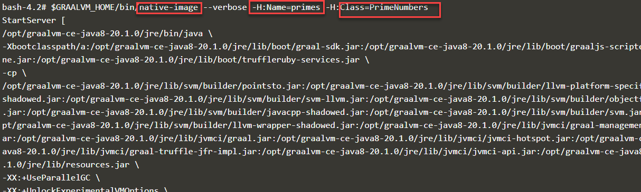
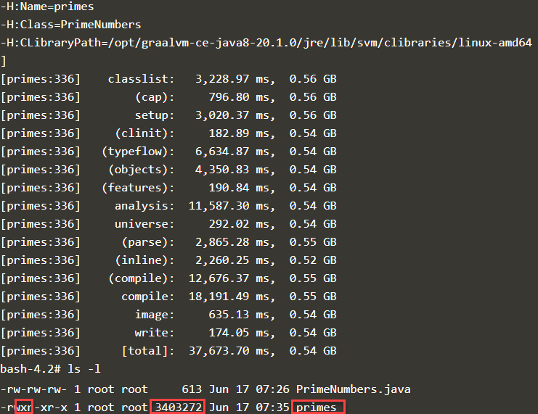

Slide 25
Ahead-of-Time Compilation
Input
Analysis
Output
Application
Points-to analysis
Run initializations
Heap snapshotting
Libraries
Machine Code
JDK
Image Heap
Substrate VM
All Java classes from your application, JDK and Substrate VM
Iterative analysis on all reachable methods, fields and classes
Native executable
Application running without dependency on JDK
Notes:
So let's see what is all happening in this Ahead of Time compiler in order to produce a native image.
At first step as input, GraalVM is taking everything that is consumed by the Java application, meaning the libraries, the JDK libraries, also resource like SubstrateVM, and what it does is a Closed World Analysis.
Closed World Analysis is an analysis of all reachable methods, fields and classes from the main class of the application. Because when you create this package binary, you don't want to include every JDK class there is, you don't want to include every library class there is. You want to package only what is used by your application, so Graal does a point-to analysis of what is reachable from the entry point of the application. Graal runs some of the static initializers and creates heap snapshots.
Then, we put everything together in a single binary. We put all the code AOT compiled code into the machine code section, and we write down a snapshot of the Java application as it was when initialized into the image heap section. This allows us to pre-initialize certain values or configuration parameters of the application, and we don't need to load them again when we start this binary.
This binary has a GC inside, so it still has some run-time system but it does no longer contain interpreter nor JIT compiler. AOT has a less advanced GC comparing it with JIT GC and no profiling data is collected for further improvement like in JIT
Startup time is probably the area where the Ahead of Time compilation is beating the JIT compilation by the largest margin

Slide 26
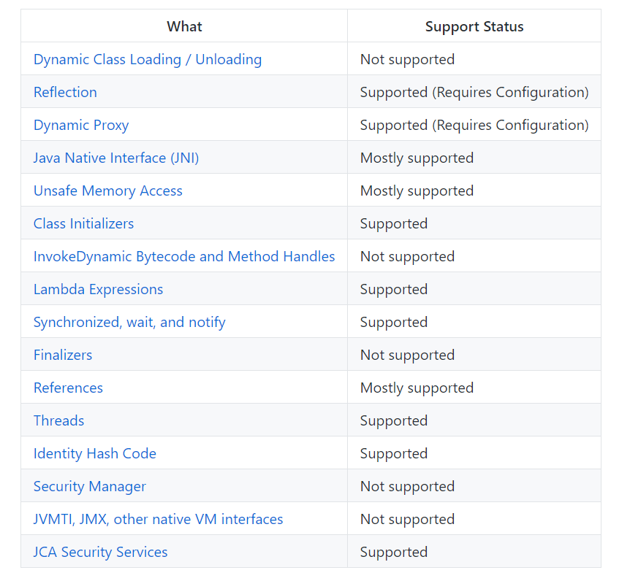
Native Image Limitations
Notes:
Native Image does not support all features of JIT. Dynamic class loading is not supported, and cannot be supported by Graal AOT execution model. During native image generation, Graal runs an aggressive static analysis that requires a closed-world assumption. For that, Graal needs to know all classes and all bytecodes that are ever reachable.
Reflection. Some types of Reflection are automatically detected by Graal and some more complex cases need an additional configuration. Reflection needs to be known, flagged ahead-of-time. Native Image tries to resolve these elements through a static analysis that detects calls to the reflection API.
Security Manager. Since there is no dynamic class loading, there is also no need for this feature.
JMX. These interfaces require access to Java bytecodes, which are no longer available at run time.
If your code is not using Dynamic class loading and you handle reflection cases carefully you should be good to go.

Slide 27
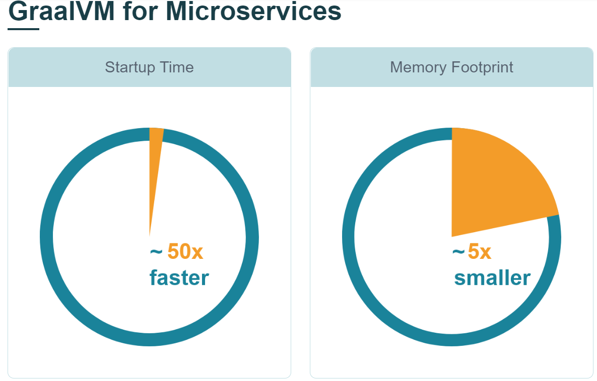
AOT vs JIT: Startup Time
JIT
Load JVM executable
Load the classes from the file system
Verify bytecode
Start interpreting
Run static initializers
First tier compilation (C1)
Run (suboptimal)
Gather profiling feedback
Second tier compilation (GraalVM or C2)
Run with best machine code
AOT
Load executable with prepared heap
Immediately start with best machine code
Notes:
First of all you load the classes, the Java byte codes from your disk, then you have to verify the byte codes, then you start interpreting your byte codes.
And then what you do on the Java HotSpot virtual machine is that you create a first-tier compilation. You use a fast compiler, which is C1, the client compiler of HotSpot to create your first machine code. You do that because you want to speed up your application as fast as possible.
Then, when a method gets really hot, meaning you've had to first compile, you've got some profile, then the method is scheduled for the second compiler, and this is when the heavyweight compiler, either the C2 compiler or the GraalVM compiler comes in and uses all the information gathered during the startup sequence of the application to create the final, hopefully, very good machine code, and then you execute faster.
As you can see there's a long sequence here, and this is the main reason why an application that is running on the Java Virtual Machine is starting up slowly.

Slide 28
AOT vs JIT: Memory Footprint
JIT
Loaded JVM executable
Application data
Loaded bytecodes
Reflection meta-data
Code cache
Profiling data
JIT compiler data structures
AOT
Loaded application executable
Application data
Notes:
First of all you load the classes, the Java byte codes from your disk, then you have to verify the byte codes, then you start interpreting your byte codes.
And then what you do on the Java HotSpot virtual machine is that you create a first-tier compilation. You use a fast compiler, which is C1, the client compiler of HotSpot to create your first machine code. You do that because you want to speed up your application as fast as possible.
Then, when a method gets really hot, meaning you've had to first compile, you've got some profile, then the method is scheduled for the second compiler, and this is when the heavyweight compiler, either the C2 compiler or the GraalVM compiler comes in and uses all the information gathered during the startup sequence of the application to create the final, hopefully, very good machine code, and then you execute faster.
As you can see there's a long sequence here, and this is the main reason why an application that is running on the Java Virtual Machine is starting up slowly.

Slide 29
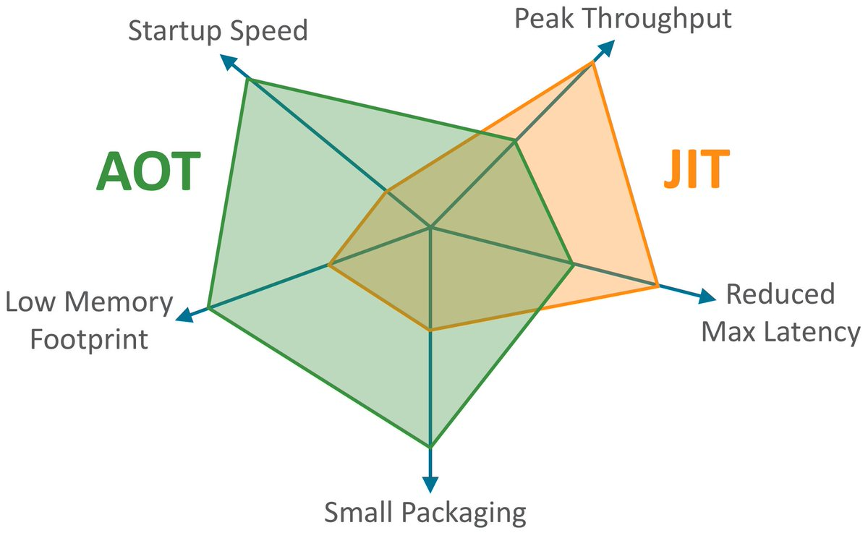
AOT vs JIT
Notes:
When we are comparing AOT vs JIT compiler we can notice that AOT mode focusses on maximized startup time, memory footprint and packaging size. And we should still use JIT when Peak Throughput and Max Latency are important. Also, the nature of how you run your application is important. For example, if the run time of your application is measured in weeks or months and the size of your heap is huge, then JIT compiler will provide you most benefits. But if you are running a small service (microservice) or even a (serverless) function, where the runtime is measured in hours, minutes, seconds then you should try AOT.
can we get AOT better? There are a couple things we're currently exploring to get AOT better on the areas where the JIT compiler currently is better. One is the profile guided optimizations where we collect the profiles up-front. Another one is we're working on a low-latency GC option also for the native images. This puts at least some max latency, the two versions at the same level. Then, we are continuously working to improve the way you can create native images by having, for example, a tracing agent that will automatically create your configuration. Currently, if you want to use native images, the best bet is to use one of the frameworks that has support for it, meaning, Helidon, Micronaut, or Quarkus, because those frameworks help you with some of the configurations you need to create that small thing.

Slide 30
Microservices – Serverless – Containers – Native (AOT)

Slide 31



Frameworks adopting GraalVM native image
Helidon SE (Oracle)
A set of Java Libraries for writing microservices
Micronaut
JVM-based framework for building light-weight modular applications (microservices)
Quarkus (Red Hat)
Kubernetes-native Java framework tailored for GraalVM and Hotspot
Notes:
Saying this all, there are already few frameworks that have adopted GraalVM and the concept of native Java images and they all are targeting cloud-native microservices: Containers (cost of cloud resources, memory) Serverless (startup time of functions) Polyglot development
In a later demo, we will dive deeper into the world of Quarkus. A supersonic, subatomic, cloud-native Java framework.

Slide 32
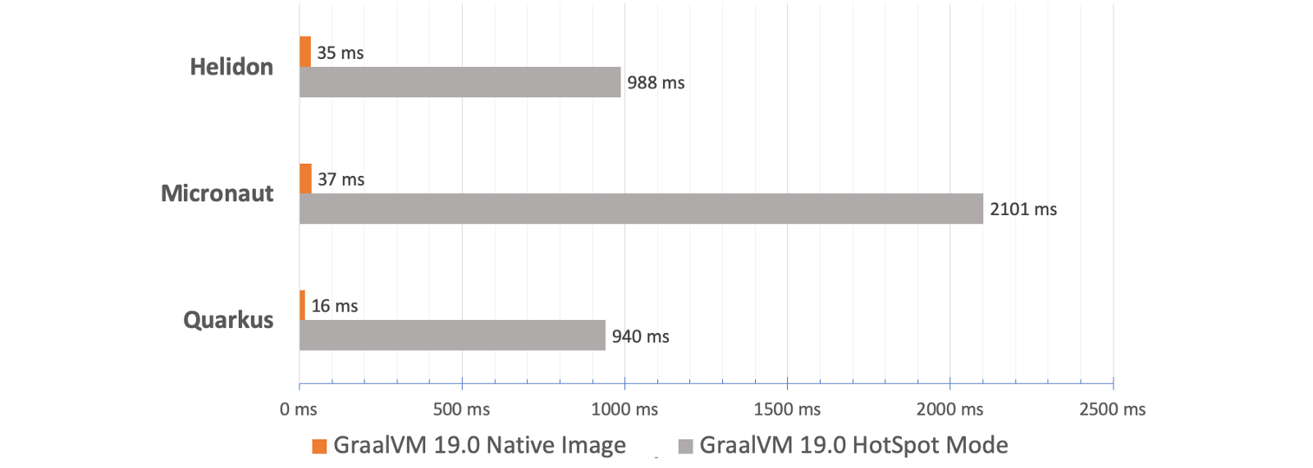
AOT vs JIT: Startup Time

Slide 33
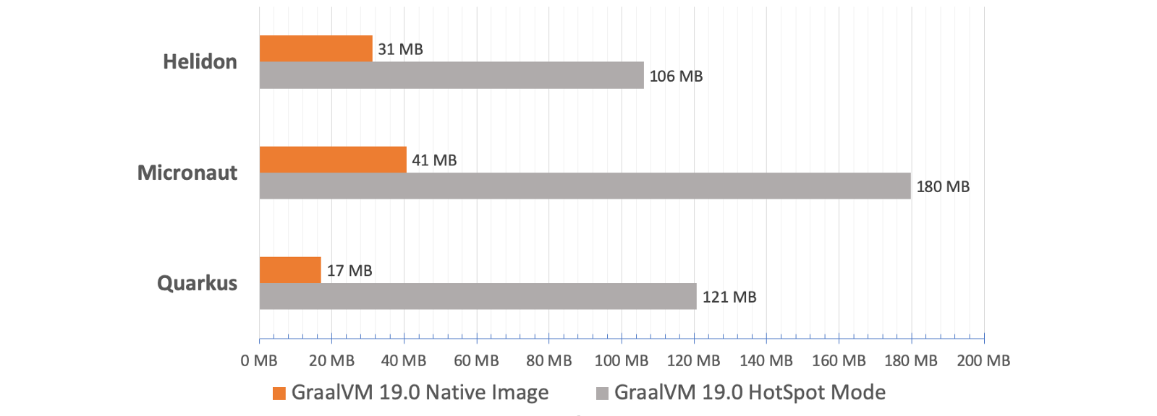
AOT vs JIT: Memory Footprint

Slide 34
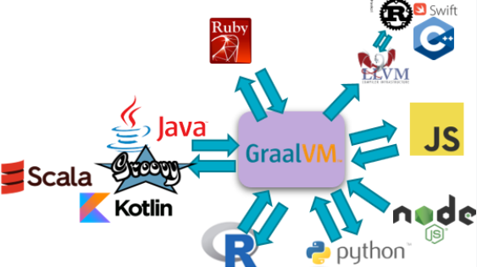
Polyglot Platform with Language Interoperability

Slide 35

Polyglot Interoperability
Establish frictionless interaction between language contexts
To benefit from the best of all wor(l)ds

Slide 36






Slide 37

Polyglot Interoperability
Establish frictionless interaction between language contexts
To benefit from the best of all wor(l)ds
Call out to ‘other world’ in a native way
Receive response in interpretable format
Minimal hoops to jump through at design time
Minimal performance overhead at run time
Uncomplicated run time environment
Despite multiple runtime execution languages
Basically: polyglot with the ease of mono-glot

Slide 38

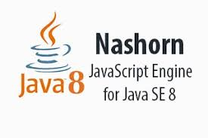
Current interoperability on JVM
Current interoperability options from Java:
file or queue based interaction
REST API
native interfaces (such as Java JNI and JNA)
JSR-223 Interoperability - for example Nashorn (and support for many other scripting languages);
intra-JVM, Java Byte code level interop between Java/Groovy/Kotlin/JRuby/Jython
Less than perfect: complex, suboptimal performance, technical limitations, variations in approach, complex runtime environments, complex testing

Slide 39

All languages are used to express and communicate very similar concepts
Meta Language (concepts, grammar, structure)

Slide 40
All programming languages are used to express and execute very similar concepts
Abstract Syntax Tree (variables, loops, conditions, calls, arithmetic)

Slide 41
GraalVM can merge and run (Java Byte) code derived from various origins
Fortran
GraalVM provides generic objects in all supported languages to make Polyglot call-outs, evaluate embedded foreign code and share data across language contexts
Thus enabling interoperability
Haskell
GraalVM Polyglot

Slide 42



The New Beast between Java and JavaScript
Out go Rhino and Nashorn
In comes GraalVM

Slide 43
From Java to JavaScript
Evaluate JS snippets
Load and call JavaScript sources
Exchange data and objects back and forth
Allow JavaScript to callback to Java objects
Run multiple JavaScript threads in parallel
Note: what applies to JavaScript by and large applies to all languages that can run on GraalVM through Truffle
Including Python, R, Ruby, WebAssembly, LLVM (C/C++, Rust, Swift,…)
Your own DSL
Notes:
https://www.npmjs.com/package/validator

Slide 44
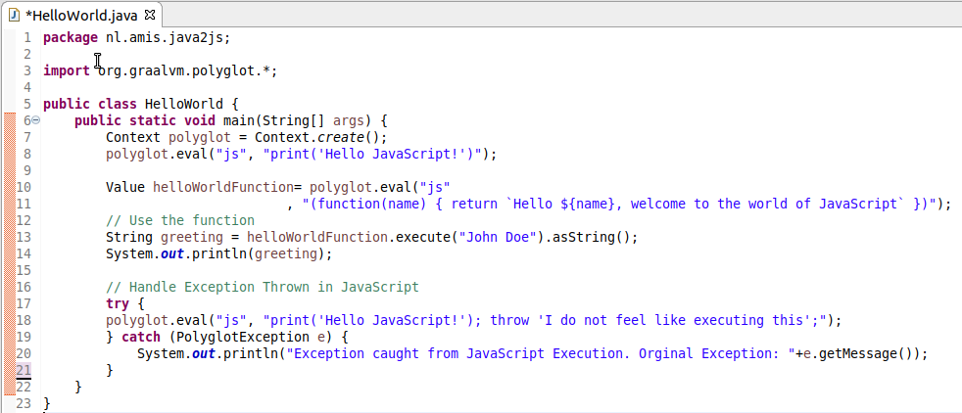
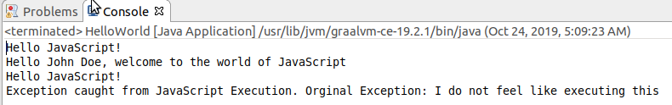
From Java to JavaScript Evaluate a Simple Code Snippet
Import Graal Polyglot package
Create Polyglot context
Evaluate Snippet
JFall 2019 - HOW AND WHY GRAALVM
Notes:
https://www.npmjs.com/package/validator

Slide 45
From Java to JavaScript Evaluate a Simple Code Snippet
Import Graal Polyglot package
Create Polyglot context
Evaluate Snippet
Evaluate Snippet => instantiate function
Execute function
JFall 2019 - HOW AND WHY GRAALVM
Notes:
https://www.npmjs.com/package/validator

Slide 46
From Java to JavaScript Evaluate a Simple Code Snippet
Import Graal Polyglot package
Create Polyglot context
Evaluate Snippet
Evaluate Snippet => instantiate function
Execute function
Handle Exception from JS
JFall 2019 - HOW AND WHY GRAALVM
Notes:
https://www.npmjs.com/package/validator

Slide 47
Call Back to Java from JavaScript
Bindings
friend <class Friendly Neighbour>
put
invoke
eval

Slide 48
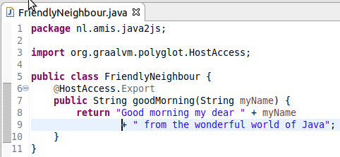
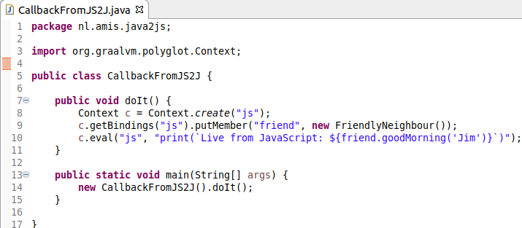
Call Back to Java from JavaScript
Bindings
friend <class Friendly Neighbour>
put
invoke
eval

Slide 49
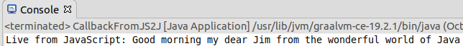
Call Back to Java from JavaScript
Bindings
friend <class Friendly Neighbour>
put
invoke
eval

Slide 50

A Typical Java Challenge (aided by JavaScript interaction)
Developing a Java application
I need to perform validations on input data
Postal Code (various countries), Mobile Phone Numbers (many countries), Email Address, Credit Card Number etc.
NPM Module Validator offers most of these OOTB
But… it is written in JavaScript
How does that help me?
Notes:
https://www.npmjs.com/package/validator

Slide 51
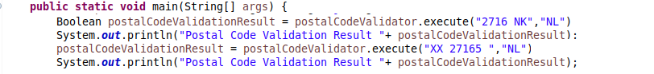
A Typical Java Challenge
Developing a Java application
I need to perform validations on input data
Postal Code (various countries), Mobile Phone Numbers (many countries), Email Address, Credit Card Number etc.
In Pseudo Code:
Notes:
https://www.npmjs.com/package/validator

Slide 52
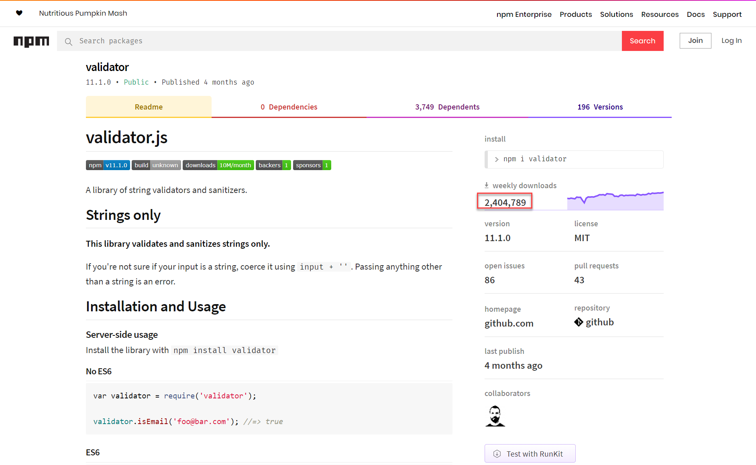
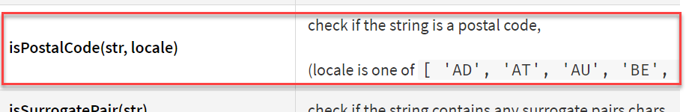
Community package in JavaScript for dozens of predefined validations
Notes:
https://www.npmjs.com/package/validator
https://www.graalvm.org/docs/reference-manual/compatibility/#validator

Slide 53
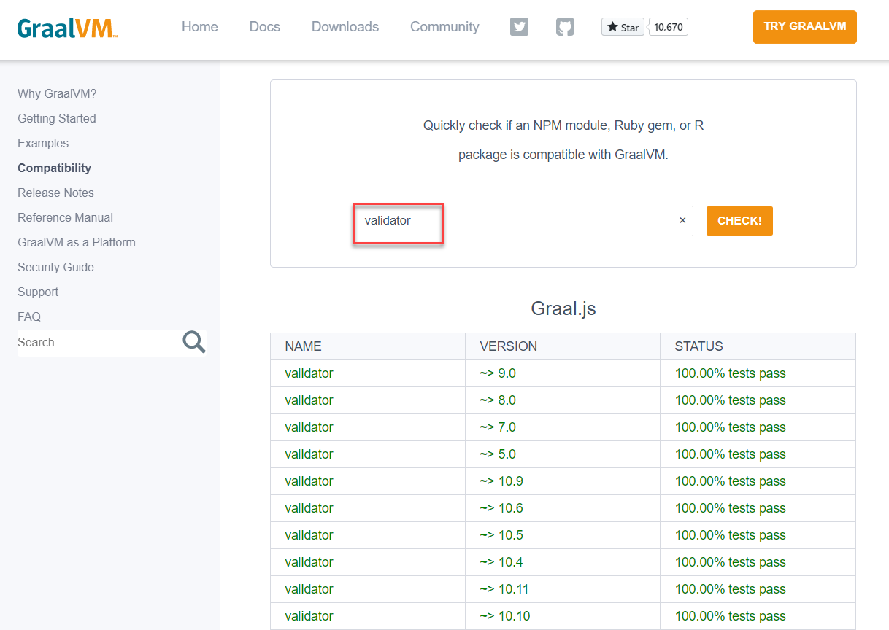
JavaScript Validator Module is compatible with GraalJS
Notes:
https://www.npmjs.com/package/validator
https://www.graalvm.org/docs/reference-manual/compatibility/#validator

Slide 54

A Typical Java Challenge – Resolved (with GraalVM)
Embrace GraalVM as the Java runtime
Install npm module validator
Install and use webpack to create a single bundle for module validator
Extend Java application
Import GraalVM Polyglot package
Create JavaScript Context
Load validator_bundled.js into context
Get desired JS functions from bindings map
Execute required JS functions
as if they were Java methods
Notes:
https://www.npmjs.com/package/validator
https://www.graalvm.org/docs/reference-manual/compatibility/#validator

Slide 55
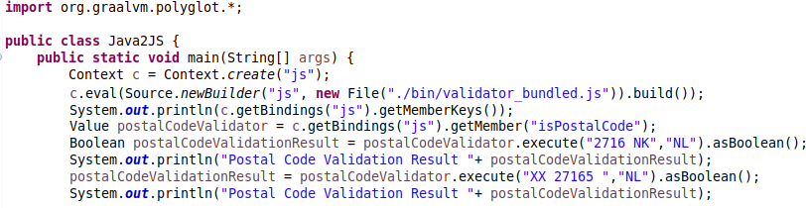
A Typical Java Challenge – Resolved (with GraalVM)
Notes:
https://www.npmjs.com/package/validator

Slide 56
Polyglot and Ahead of Time Compiled Native Binary
A multi-lingual or polyglot Java application can be turned into a Native Binary Executable using GraalVM Ahead of Time compilation
Non JVM-languages can be included but are not compiled ahead of time
The build process for the binary executable takes long & uses a lot of memory
The outcome: a single, smal[lish] file running on plain Linux with fast startup & low memory footprint
For example in Alpine Linux Container or in Linux Binary Serverless Function
Fortran
Haskell
GraalVM Polyglot
GraalVM
Native Image
(binary executable)
application

Slide 57
Polyglot from Node | Python | Ruby | R| … to any language on GraalVM

Slide 58
Polyglot from non-JVM languages
Fortran
Any language running on GraalVM can participate in Polyglot interoperability
Evaluate & Execute Snippets in other languages
Export data and objects through the Polyglot Map to other execution contexts
Import data and objects from the Polyglot Map from other language contexts
Read, write & execute
Interacting with JVM based languages is slightly different
Use Java Type to construct native object based on a Java Class
Haskell
GraalVM Polyglot

Slide 59



Polyglot from non-JVM languages Dutch National Police Case: Scala ⬄ (Fast)R on GraalVM
GraalVM Polyglot

Slide 60
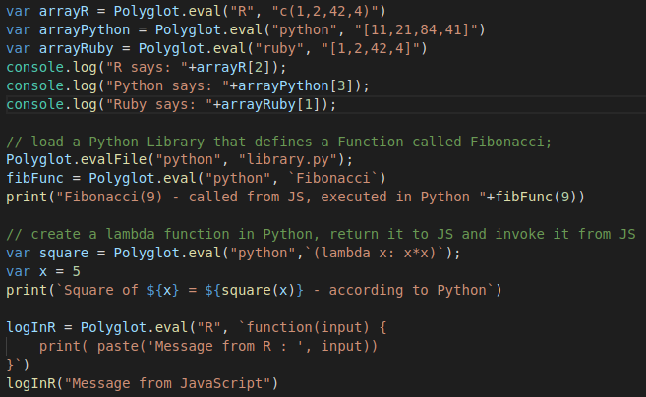
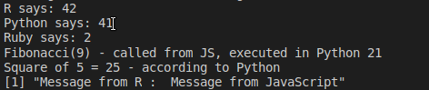
Polyglot from JavaScript to other Graal Truffle Languages
Polyglot.eval can execute any language snippet
It returns data objects (to read/write) or functions (that can be executed)
GraalVM Polyglot

Slide 61
Polyglot from JavaScript to other Graal Truffle Languages
Polyglot.eval can execute any language snippet
It returns data objects (to read/write) or functions (that can be executed)
GraalVM Polyglot

Slide 62
Node Application calling out to Java (and others)
GraalVM can run Node & JS applications
GraalJS /GraalVM can replace V8 as interpreter & execution engine
GraalJS runs Java Byte code on JVM
This engine is a Java application that works on any Java 8+ implementation
Can run faster and better scalable to big memory structures
However: it may need some warmup time to reach peak performance
GraalVM 20.1: based on Node 12.15 and ECMAScript 2020 compliant
Node application running with GraalVM can leverage GraalVMs Polyglot – with Java as well as other languages (R, Ruby, Python, C++, …)
Evaluate Code Snippets, Instantiate Objects, Share Data
Notes:
var FileClass = Java.type('java.io.File'); var file = new FileClass("myFile.md");
https://www.graalvm.org/docs/reference-manual/languages/js/
https://github.com/graalvm/graaljs/blob/master/docs/user/JavaInterop.md
Node.js applications running on GraalVM's JavaScript engine have access to all of Node.js' APIs, including built-in Node.js' modules such as 'fs', 'http', etc. Conversely, JavaScript code embedded in a Java application has access to limited capabilities, as specified through the Context API, and do not have access to Node.js' built-in modules.

Slide 63
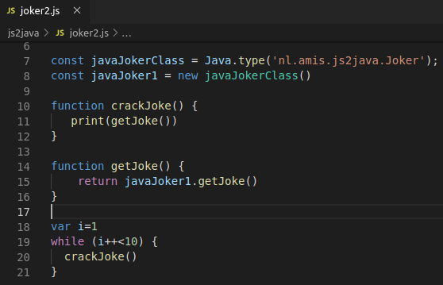
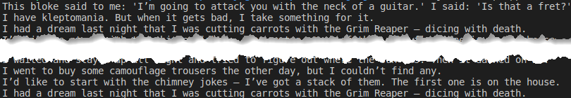
Node Application calling out to Java
application-bundle.jar
Node Application
Joker.class
GraalJS
Java 11 APIs
JVM & GraalVM
Notes:
var FileClass = Java.type('java.io.File'); var file = new FileClass("myFile.md");
https://www.graalvm.org/docs/reference-manual/languages/js/
https://github.com/graalvm/graaljs/blob/master/docs/user/JavaInterop.md
Node.js applications running on GraalVM's JavaScript engine have access to all of Node.js' APIs, including built-in Node.js' modules such as 'fs', 'http', etc. Conversely, JavaScript code embedded in a Java application has access to limited capabilities, as specified through the Context API, and do not have access to Node.js' built-in modules.

Slide 64
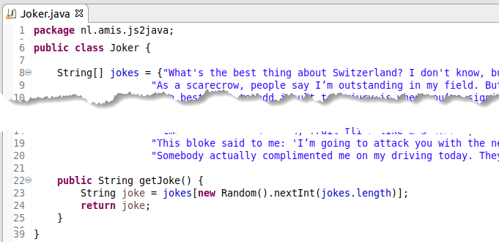
Node Application calling out to Java
Get hold of Java Class and instantiate Java Object
Invoke method on Object and get String returned
application-bundle.jar
Node Application
Joker.class
Notes:
https://www.graalvm.org/docs/reference-manual/languages/js/
https://github.com/graalvm/graaljs/blob/master/docs/user/JavaInterop.md
Node.js applications running on GraalVM's JavaScript engine have access to all of Node.js' APIs, including built-in Node.js' modules such as 'fs', 'http', etc. Conversely, JavaScript code embedded in a Java application has access to limited capabilities, as specified through the Context API, and do not have access to Node.js' built-in modules.

Slide 65
Conclusion

Slide 66
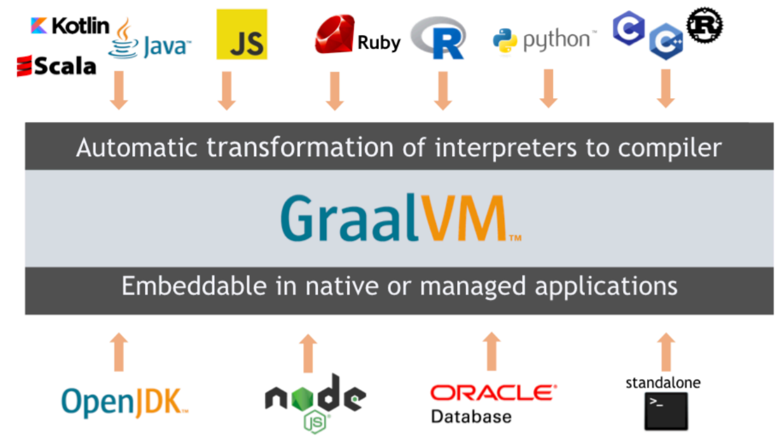
Quick Recap – What is GraalVM?
Thomas Wuerthinger: “a new virtual machine that is trying to execute many languages faster”
JIT Foundation for the Long Term Evolution of HotSpot JVM
Stable, observable, manageable and maintainable JVM with optimizations for modern Java and JVM language patterns
Serverless Java
Small footprint, rapid startup time, simple & small run time
Interoperability platform aka Polyglot VM
Run and interact between many languages
Bonus features
Custom DSL
Native interaction between C/C++ and Java
Polyglot Tools: Debugger (with Chrome Dev Tools), Profiler, GraalVM VisualVM, Ideal Graph Visualizer, Visual Studio Code extension for GraalVM
Notes:
https://www.graalvm.org/docs/reference-manual/tools

Slide 67
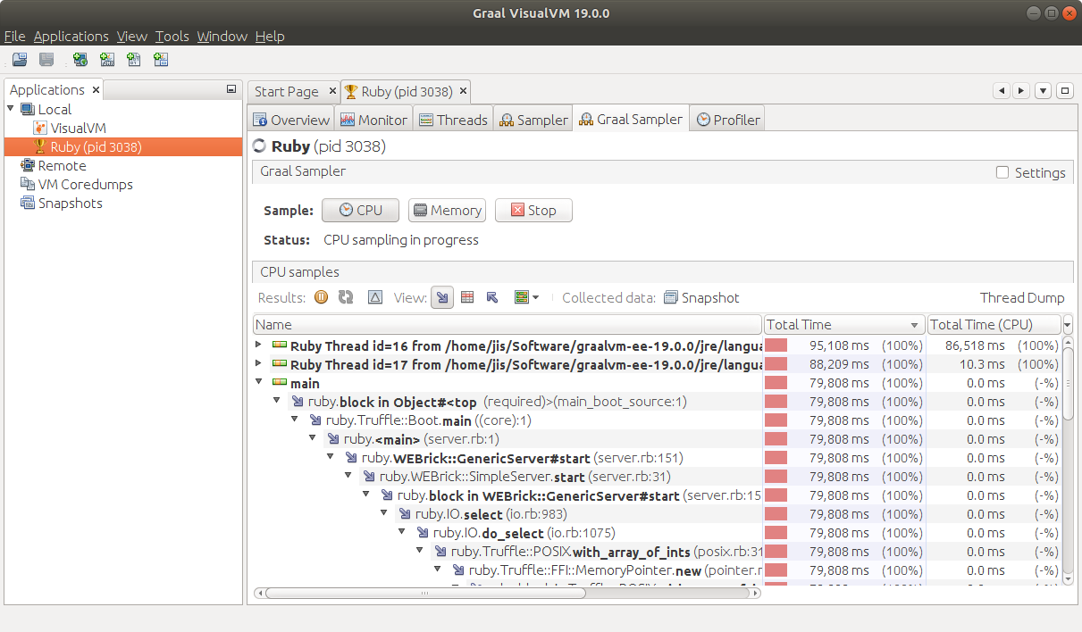
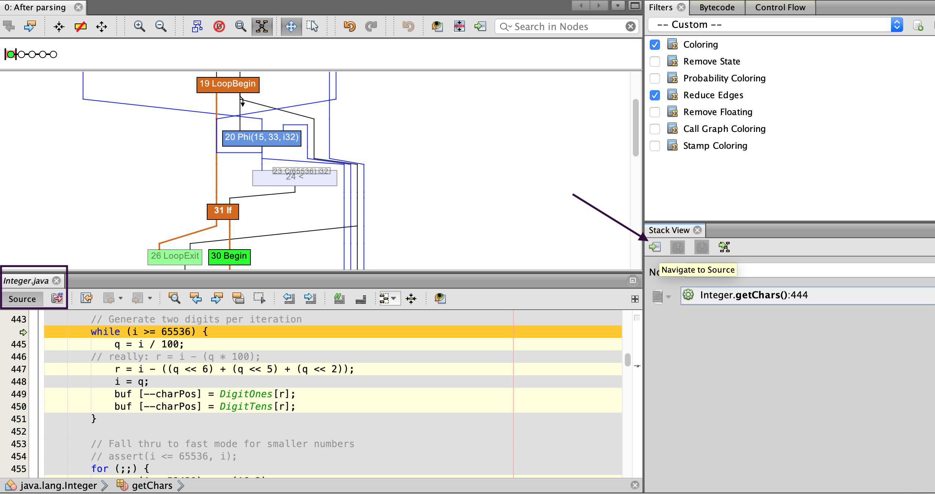
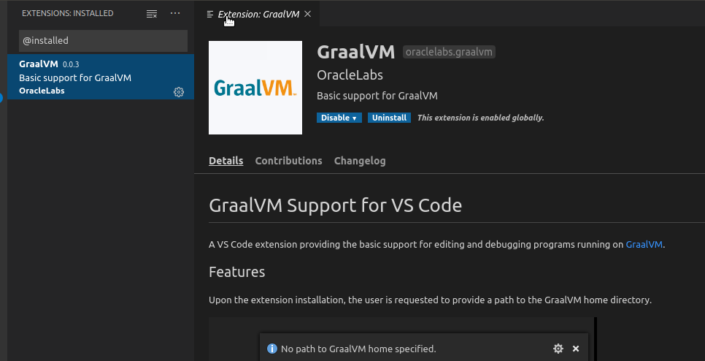
Tools in the GraalVM Ecosystem
Debugger linked to Chrome DevTools
Profiler – command line CPU Sampler, CPU tracer and Memory tracer
Graal VisualVM – Visual CPU Sampler, Heap Analyzer
Visualizing Java Flight Recorder data
Ideal Graph Visualizer
view and inspect interim graph representations from GraalVM and Truffle compilations
Visual Studio Code Extensions
Editing and debugging applications running on GraalVM
Notes:
https://visualvm.github.io/graal.html
https://github.com/oracle/graal/tree/master/vscode/graalvm
https://www.graalvm.org/docs/reference-manual/tools/#visual-studio-code-extensions-for-graalvm
https://www.graalvm.org/docs/reference-manual/tools/

Slide 68


Adopting GraalVM in your team - your first steps
Start exploring GraalVM – download & install, play and do a PoC
Plenty of resources available (code samples, blog articles, tutorials, ..)
Hybrid: have some containers running GraalVM (for Java applications) instead of your traditional JVM brand
to try out, check if it is stable and performant and (better) manageable
Start leveraging polyglot
single runtime for different programming languages)
interoperability (benefit in Java from 3rd party libraries in JavaScript or Python [or vice versa] and/or make better use of the skills in your team)
better start creating standards and guidelines around when and how to polyglot!
AOT/native - use GraalVM to build Java applications as native executables as last step in the build process and deliver that executable instead of JAR files
create Java based Serverless Functions with small footprint and very quick startup
benefit from ultra fast and super small frameworks (Quarkus, Helidon, Micronaut, Vert.x, Spring, …)
Haskell
Fortran
GraalVM Polyglot

Slide 69



Thank you for your attention
Slides:
https://bit.ly/acesathome-graalvm
Live Handson Environments
bit.ly/graalvm-handson
lucas.jellema@amis.nl | technology.amis.nl | @lucasjellema | lucas-jellema

Slide 70

@lucasjellema

